Slide 1

Intel Do-It-Yourself Challenge Intel Galileo and Edison http://www.intel.com/content/www/us/en/do-it-yourself/galileo-maker-quark-board.html
Paul Guermonprez www.Intel-Software-Academic-Program.com paul.guermonprez@intel.com Intel Software 2014-02-01

Slide 2
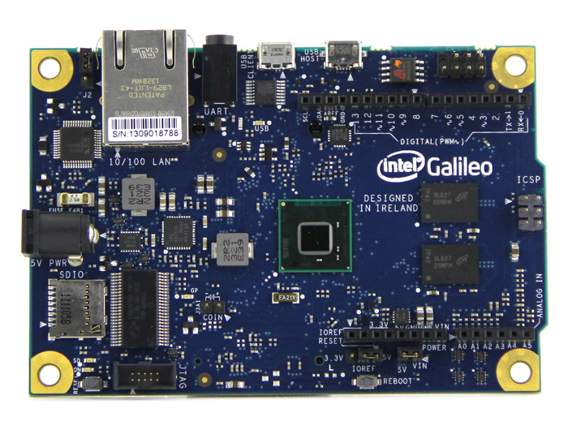
Intel Galileo ? Arduino ?
You may know Arduino … but do you know there’s an Arduino board with an Intel processor on it ?
That’s the Galileo board, with Intel Quark processor (SoC).

Slide 3
Intel Galileo / Arduino R3

Slide 4
Processors and IO
Arduino Uno R3
Based on the ATmega328 8-bit microcontroller.
USB port, power jack, 14 I/O pins, ICSP header. http://arduino.cc/en/Main/arduinoBoardUno
Intel Galileo
Intel Quark System-on-Chip (SoC) x1000 with a 32bit core running at 400MHz.
Connections : mini-PCI Express, 100Mb Ethernet port, Micro-SD slot, RS-232 serial port, USB Host, USB Client. http://www.intel.com/content/www/us/en/do-it-yourself/galileo-maker-quark-board.html

Slide 5
Compatiblity
Hardware and software with Arduino
Galileo is designed to be sw and hw compatible with Arduino Uno R3 boards.
If you can plug an extension shield on an Arduino Uno R3, you can plug it on an Intel Galileo.
You can reuse your scripts from the Arduino IDE.
X86 !
But it’s also a full x86 processor (Pentium class).
So you can run tons of regular linux x86 binaries !

Slide 6
Linux Yocto
Full linux server
A microcontroller based Arduino can accept and run simple binaries compiled for it by the IDE. But Galileo is a lot more powerful and you have a full linux system running on it. There’s an Ethernet port on the board, ssh to your Galileo ! No need for an additional ARM processor shield for your Arduino, you already have a powerful intel System-on-Chip.
Build your own, write SD card, boot with grub
The distrib is Yocto, it’s open, you can rebuild your system yourself, write on a SD card and boot from it (grub).

Slide 7
IO

Slide 8
Storage and IO
Micro SD slot
Insert here an SD card with a embedded Linux image ! You can custom your own Linux configuration and run it on the board.
Mini PCI Express slot
Located on the bottom side of the board, this slot allow you to plug any compatible mini PCI express card to use it with your Linux system. Commonly, we like to plug here a WiFi or Bluetooth or GSM adaptor.
RS232 – Serial port
We usually use USB or ethernet to access the board, but there’s a serial port too (you may need an UART-USB adaptor)

Slide 9
USB
USB Client
Connector you have to use to plug the board to your computer. The board will act as a client for your computer (your board is a device for your computer).
USB Host
The board will act as a host with this connector. You can connect here a keyboard, a mouse or even a smartphone…

Slide 10

Network
Ethernet
An Ethernet port included in your Arduino board ! No shield needed. Galileo is a full little linux x86 server.
WiFi
The mini PCI-express port is usually used to plug a laptop-style WiFi card. It’s very cheap and very small. There’s lot of drivers for most intel WiFi cards.

Slide 11
IO
JTAG connection : test access port to determine if your card has been well manufactured. It’s also useful to check logical signal on all I/O of the board. Real time clock (2-pin coin cell battery connector) : connect a 3.0V cell battery here to keep Real Time clock updated, even when the board Is off. 6-pin ICSP connector (stands for In-Circuit Serial Programming) : program the board using an ICSP programmer, connected to your computer via USB. TWI/I2C (stands for Two Wire Interface / Inter Integrated Circuit) : Developed by Philips in 1982, it is a data bus commonly used by multimedia devices (such like TVs and hifi). In theory, you can control your devices using this connector. 14 I/O pins (digital connectors) 6 I/O pins (analog connectors) : Originally from Arduino board, allow you to connect Arduino shield, but can also be used directly with wires to connect everything you want to your Galileo board. 6 I/O digital pins can be used with Pulde-Width Modulation (PWM, ~ on the board).
IOREF allow a shield to adapt voltage provided by the board (switch between 3.3 and 5V). AREF is not supported by Intel Galileo

Slide 12
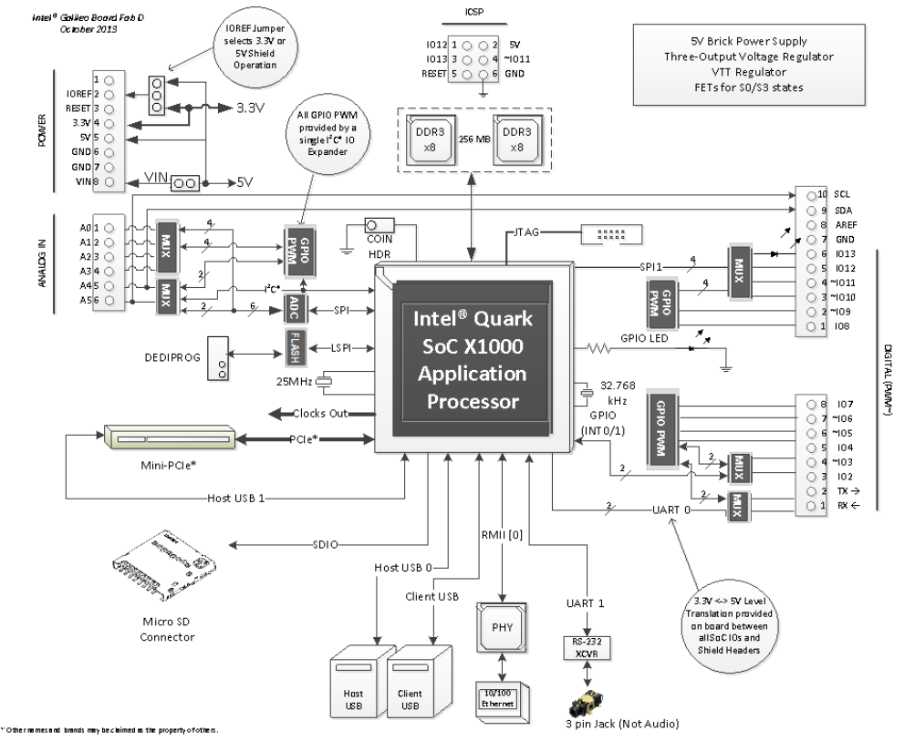

Slide 13
Potential

Slide 14
Arduino + x86 server !
Software
It’s good to be Arduino compatible for scripts, but having full x86 capability to run existing linux binaries allows you to do a lot more and reuse code from PCs and servers.
Processing power
A Pentium class 32bit core running at 400MHz will allow you do analyse the sound, images, run a web server, …
Hardware
Ethernet is already on the board, but WiFi mini PCIe laptop-style cards are small and cheap.

Slide 15
Focus on linux
Arduino scripts or direct linux ?
We’ll focus in the following courses on linux projects, connecting directly to the embedded linux on the board. We’ll use the Arduino IDE to show you how to run Hello World.
Yocto
Yocto is free (as in speech) and it’s a regular linux, no surprises ;-)

Slide 16
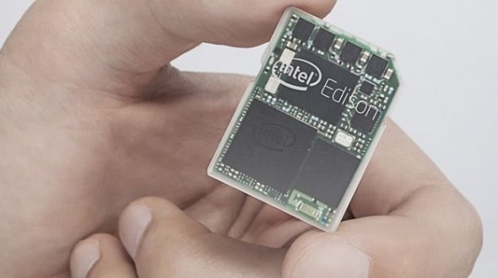
Intel Edison
Galileo great for PoCs but …
It’s great to have all the IO and ports of Galileo to test and prototype, but it may be difficult to build a very compact product with it.
Edison !
So Intel will release soon Edison, a SD-card sized computer with Intel Quark inside.
Develop your proof of concept with Galileo, and use Edison if you need something smaller ! http://www.intel.com/content/www/us/en/do-it-yourself/edison.html

Slide 17
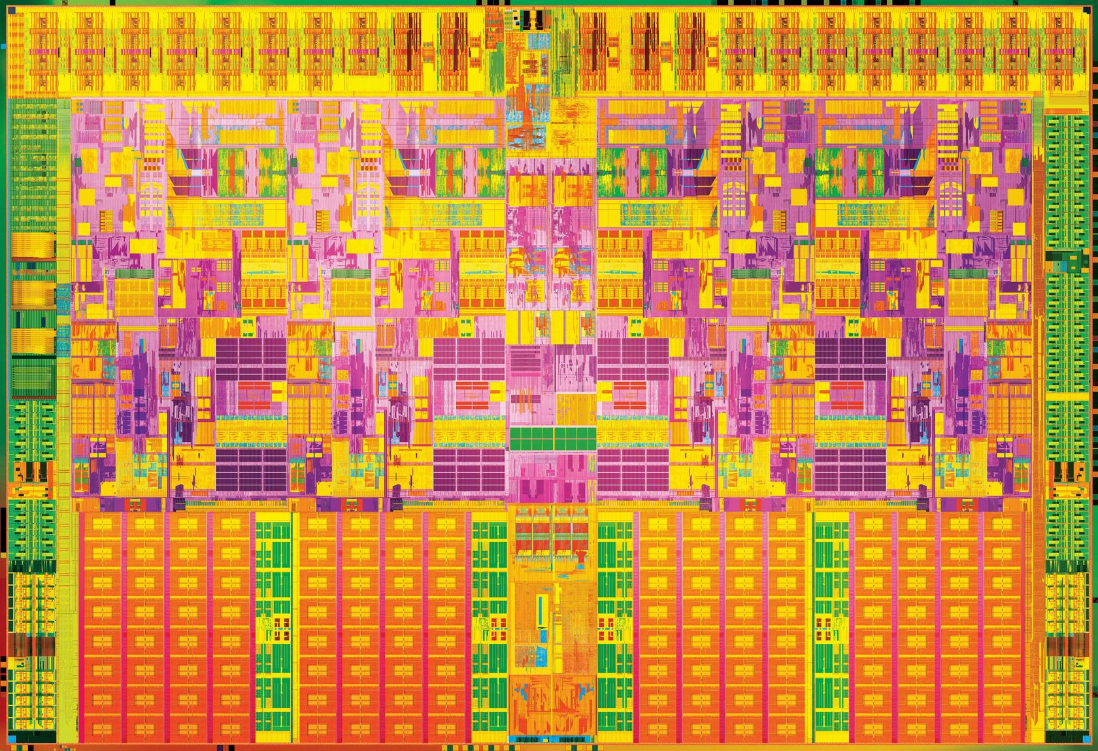

Slide 18
License Creative Commons – By 3.0
You are free:
to Share — to copy, distribute and transmit the work
to Remix — to adapt the work
to make commercial use of the work
Under the following conditions:
Attribution — You must attribute the work in the manner specified by the author or licensor (but not in any way that suggests that they endorse you or your use of the work).
With the understanding that:
Waiver — Any of the above conditions can be waived if you get permission from the copyright holder.
Public Domain — Where the work or any of its elements is in the public domain under applicable law, that status is in no way affected by the license.
Other Rights — In no way are any of the following rights affected by the license:
Your fair dealing or fair use rights, or other applicable copyright exceptions and limitations;
The author's moral rights;
Rights other persons may have either in the work itself or in how the work is used, such as publicity or privacy rights.
Notice — For any reuse or distribution, you must make clear to others the license terms of this work. The best way to do this is with a link to this web page.
http://creativecommons.org/licenses/by/3.0/

